Slide 1
607 Project Presentation Predictive Maintenance Classification of Industrial Machines
Presented By:
Aung Khant Min 30160164
Yi-Chi Chang 30156294
Peerada Tarasub 30178664
Yat Hei Fung 30183611
Hao Su 30191442

Slide 2
1
OVERVIEW

Slide 3
1. Overview
1
Introduction
Machine failure in industrial plant leads to large amount of cost and time to fix or replace the machine, which affect the performance of the whole production line.
To avoid that, preventive maintenance is the practice that most industrial plants perform to reduce the event of sudden machine failure.
Performing predictive maintenance can improve machine downtime, costs, control, and quality of production.
2
Objective
Compare the performance of different machine learning algorithms on predicting machine failures.
Classify the failure types of the failed machines.

Slide 4
2
DATASET

Slide 5
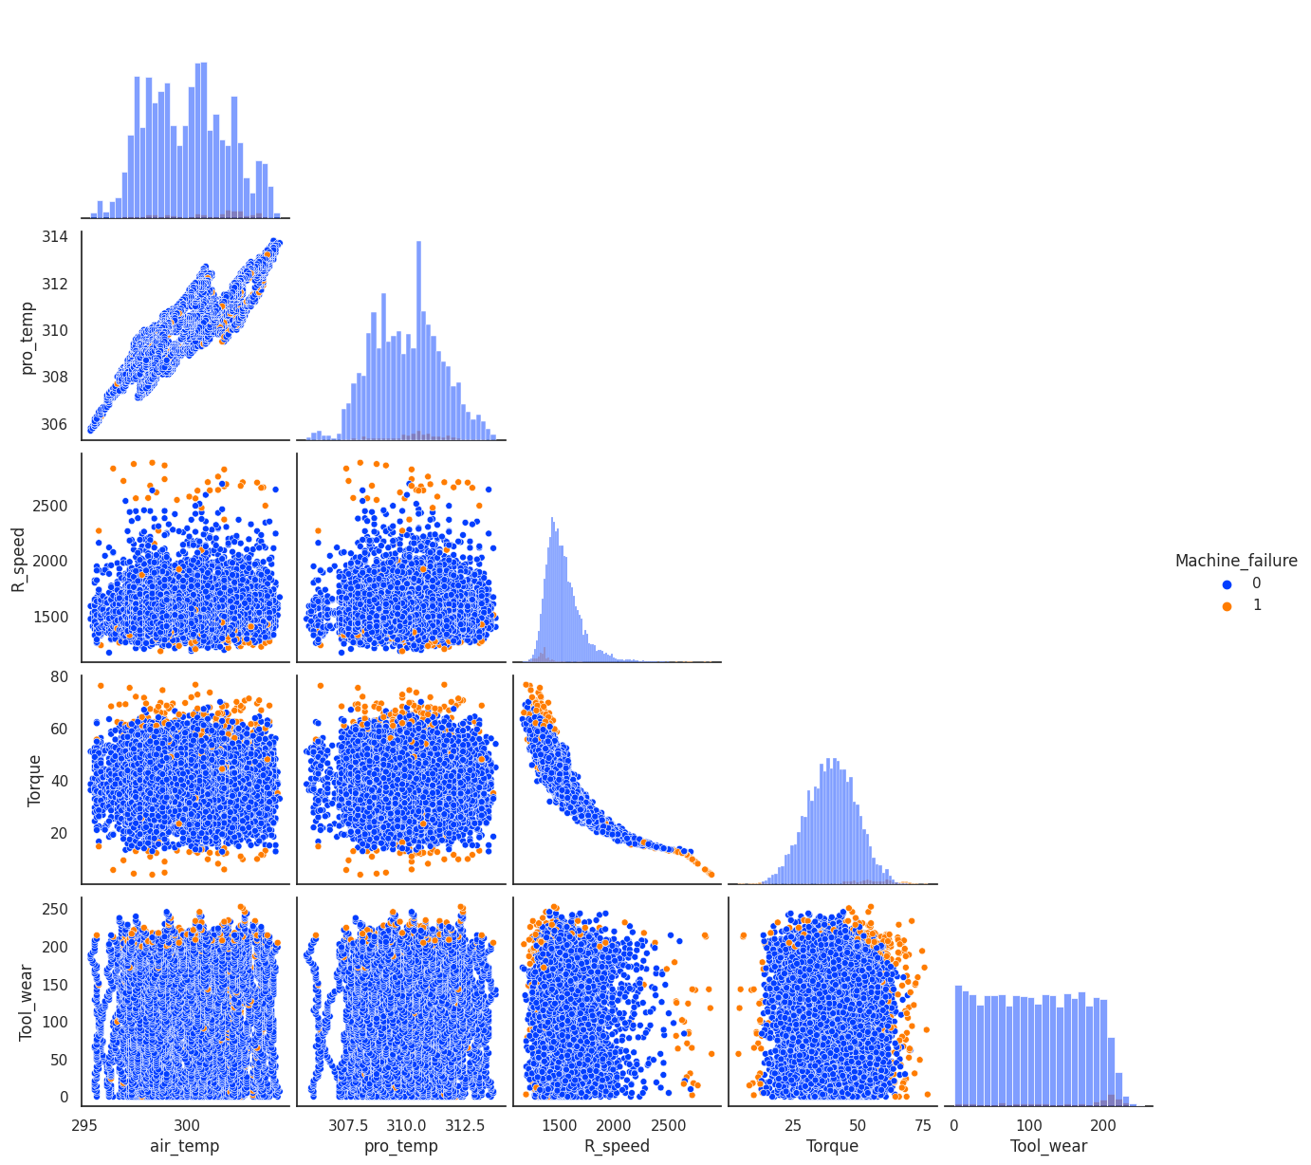
2. Dataset
Column Name | Description
UDI | Unique identifier ranging from 1 to 10000
Product ID | A variant-specific serial number for each product -> L (low), M (medium), H (high)
Type | Machine type -> L (low), M (medium), H (high)
Air temperature [K] | Air temperature
Process temperature [K] | Process temperature
Rotational speed [rpm] | Rotational speed
Torque [Nm] | Torque values
Tool wear [min] | The quality variants H/M/L add 5/3/2 minutes of tool wear to the used tool in the process
Machine failure | Indicate whether the machine has failed for any of the following failure modes are true.
TWF | Tool wear failure
HDF | Heat dissipation failure
PWF | Power failure
OSF | Overstrain failure
RNF | Random failures
Obtained from the UCI Machine Learning Repository, which is synthetic that reflects real predictive maintenance encountered in the industry because real datasets are generally difficult to obtain.
Contain 10,000 data points.

Slide 6
3
METHODOLOGY

Slide 7
3. Methodology
1
Classify whether the machine will fail or not
2
Classify what type of machine failure it experiences
Report the results of classification (Q2)
TWF
(Tool wear failure)
Classify whether the machine will fail or not
Raw Data
Machine Learning Algorithms
HDF
(Heat dissipation failure)
Neural Network
Classify the type of machine failure
PWF
(Power failure)
Machine fail?
Machine Learning Algorithms
OSF
(Overstrain failure)
Report the results of classification (Q1)
True
Neural Network
False
RNF
(Random failure)
Fail
Not fail
Notes:
pp

Slide 8
3.1 Classify whether the machine will fail or not
Encode the Machine Type column
(Categorical Variable)
Fit the data using LazyClassifier
Fit the data using several machine learning algorithms
Fit the data using neural network
Lazy Predict helps build a lot of basic models without much code and helps understand which models works better without any parameter tuning.
Calculate and compare the accuracy
Notes:
pp

Slide 9
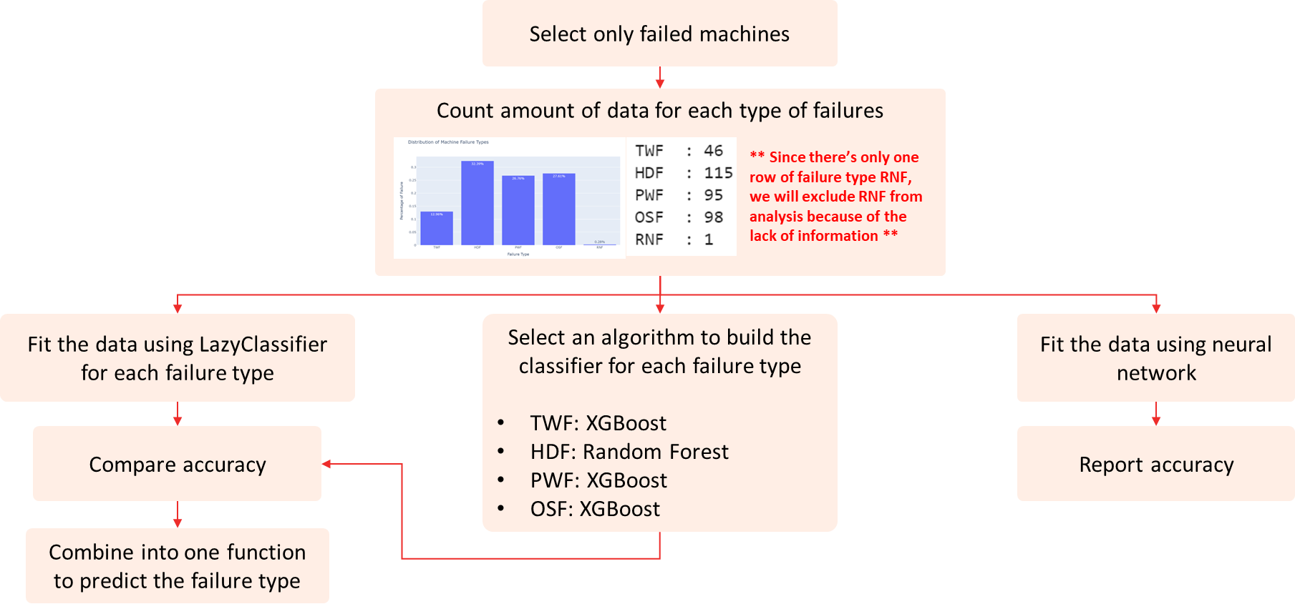

Slide 10
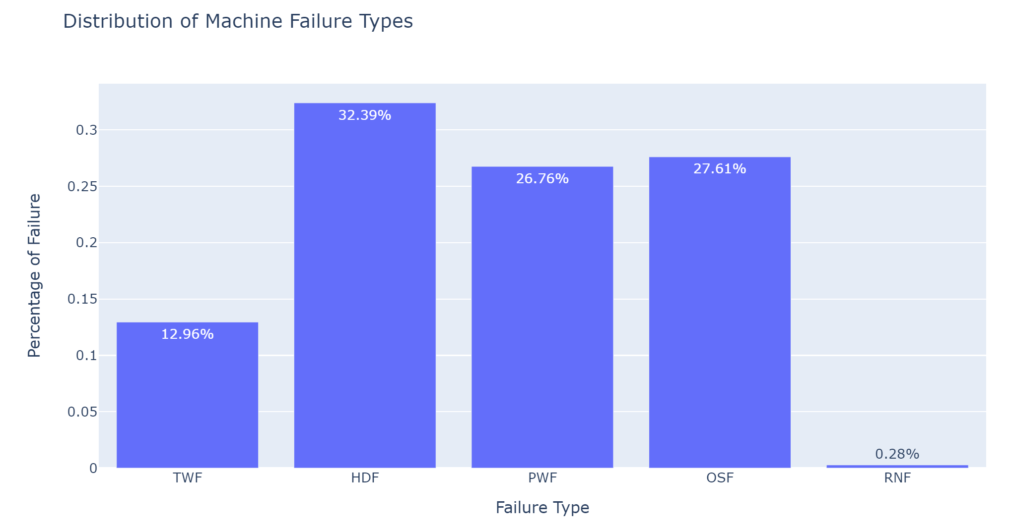
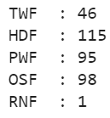
3.2 Classify what type of machine failure it experiences
Select only failed machines
Count amount of data for each type of failures
** Since there’s only one row of failure type RNF, we will exclude RNF from analysis because of the lack of information **
Fit the data using LazyClassifier for each failure type
Select an algorithm to build the classifier for each failure type
TWF: XGBoost
HDF: Random Forest
PWF: XGBoost
OSF: XGBoost
Fit the data using neural network
Compare accuracy
Report accuracy
Combine into one function to predict the failure type
Notes:
pp

Slide 11
RESULT
Q1: Classify whether the machine will fail or not
4
Notes:
bo

Slide 12
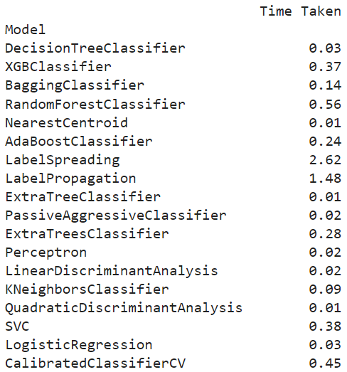
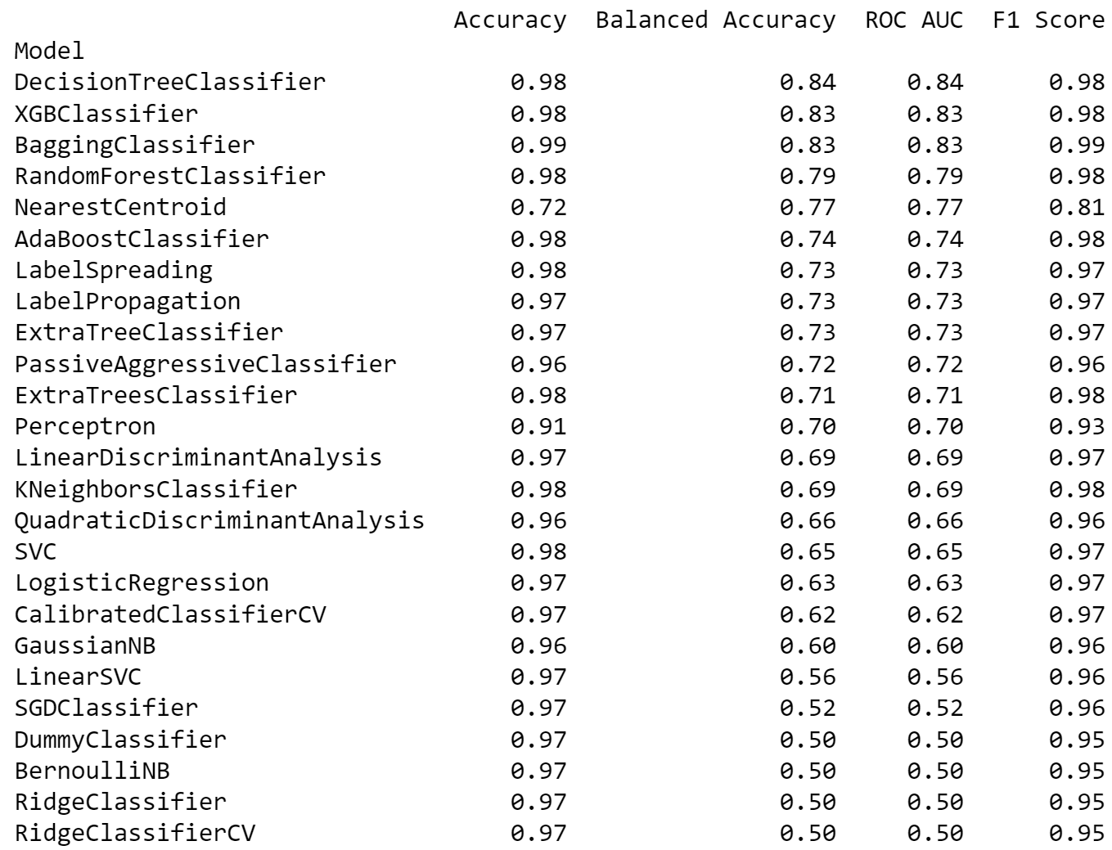
4.1 Classify whether the machine will fail or not
Lazy Classifier
1
Notes:
Here we fitted the data using LazyClassifier to find out which models are most suitable to classify whether the machine will fail or not. The list is order by the balanced accuracy, in which the top 4 models and SVC and KNN are used for evaluation and comparing which model performs the best.

Slide 13
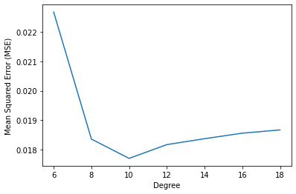
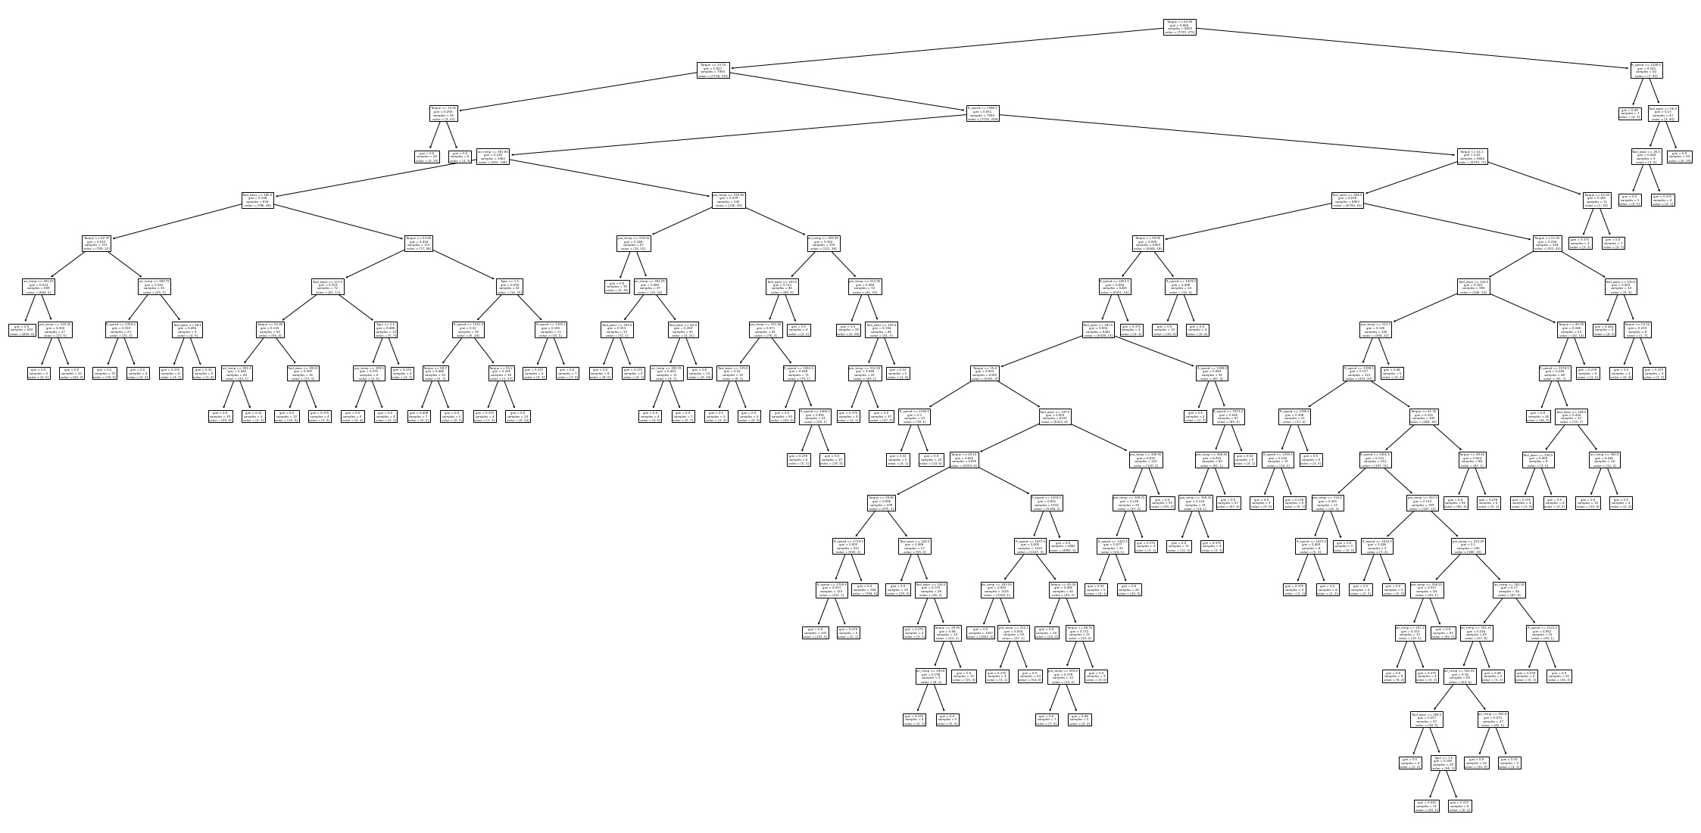
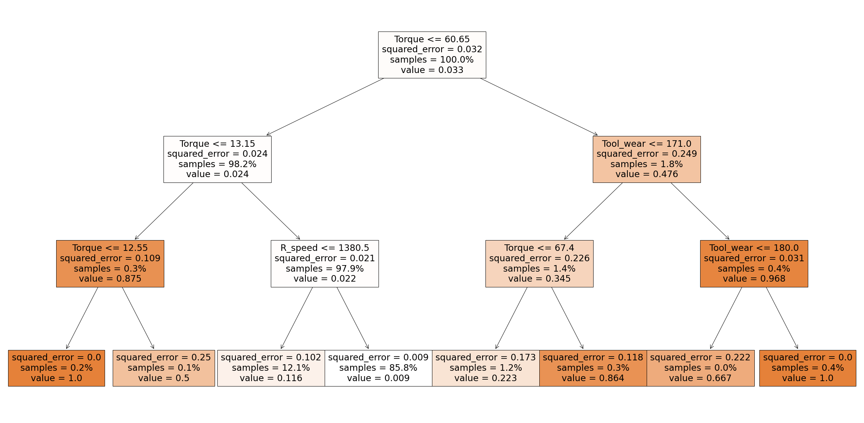
4.1 Classify whether the machine will fail or not
Decision Tree Classifier and Bagging Classifier
Gini criterion, Misclassification = 0.0185, F1-score = 0.8423
2.1
Predict \ Actual | Normal | Failure
Normal | 1921 | 18
Failure | 19 | 42
Entropy criterion, Misclassification = 0.0195, F1-score = 0.8338
Predict \ Actual | Normal | Failure
Normal | 1920 | 19
Failure | 20 | 41
Optimal Degree is 10
Bagging classifier, Misclassification = 0.013 , F1-score = 0.8714
Predict \ Actual | Normal | Failure
Normal | 1930 | 9
Failure | 19 | 42
Notes:
First, we used decision tree classifier, in which the optimal degree is chosen by the lowest value of MSE. Here we selected 10 as the optimal degree. Then, we tried to used different classification criteria, Gini and Entropy, for splitting the nodes to find out which criterion performs better. As you can see, the Gini criterion has lower misclassification rate and higher F1-score, which means it outperforms Entropy criterion. Since the entire tree is too large, we pruned the tree into a tree with depth of 3 degree. Torque is the first feature used to separate data into 2 groups of 98.2% and 1.8% samples respectively.
We also implemented bagging classifier and it turns out having a even better result of lower misclassification rate of 0.013 and higher F1-score of 0.87.

Slide 14
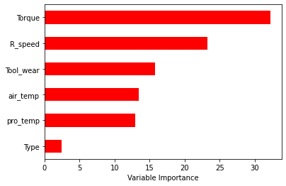
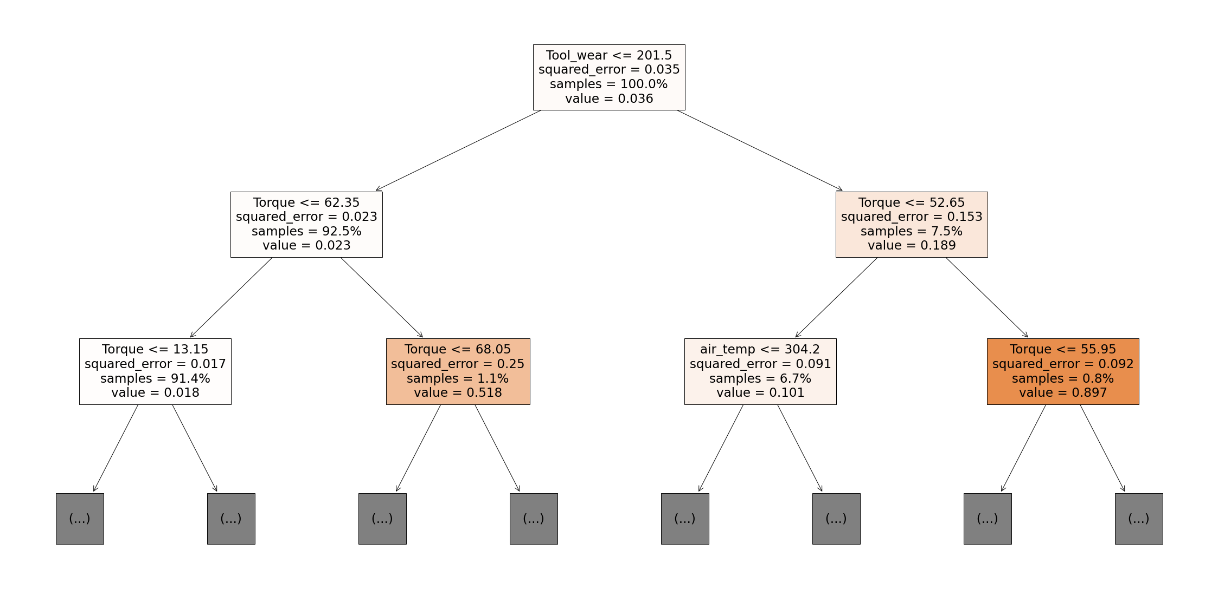
4.1 Classify whether the machine will fail or not
Decision Tree by Random Forests
2.2
Parameters
n_estimators = 100
max_features =6
Criterion = squared_error
Results
Best number of estimator: 79
Misclassification rate: 0.0132
F1-Score = 0.848
Predict \ Actual | Normal | Failure
Normal | 1932 | 7
Failure | 24 | 37
Notes:
Random forests is then implemented and we tried to use 100 estimator, maximum features of 6 with squared error as criterion. After that, the best tree is selected, in which the 79th has the best performance that misclassification rate is 0.0132 and F1-Score is 0.848. Although torque is the most important feature, it is not the first feature used to separate data. Nevertheless, it still very efficient to classify data as 5 out of 6 nodes use torque as the criterion.

Slide 15
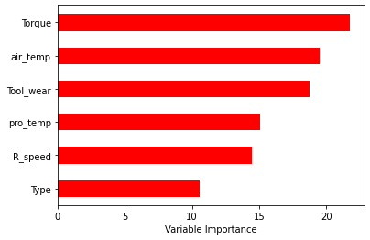
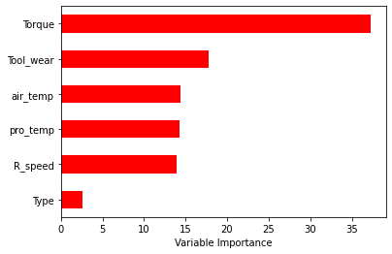
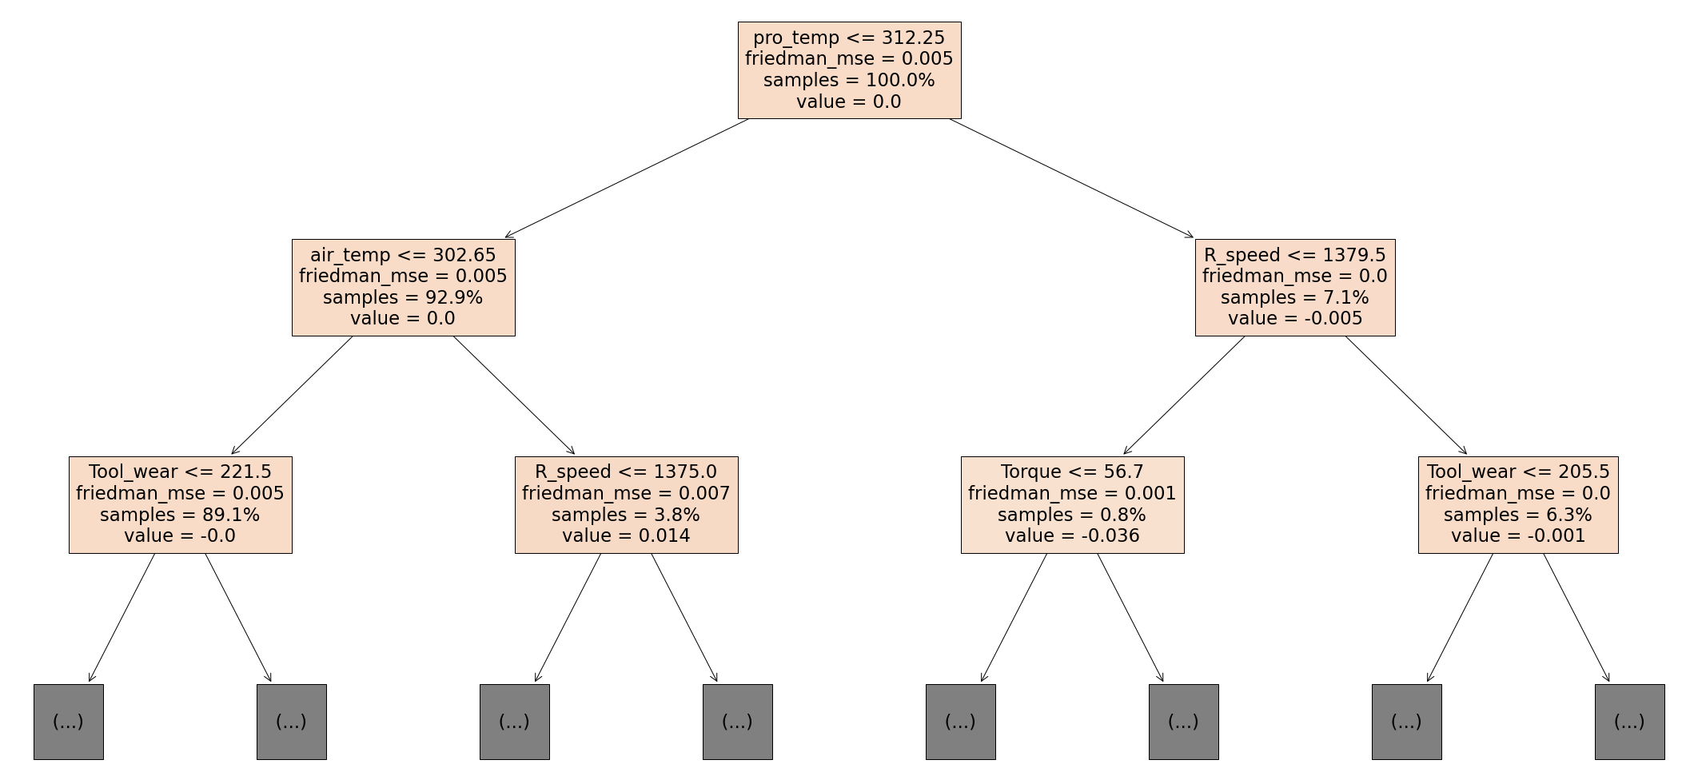
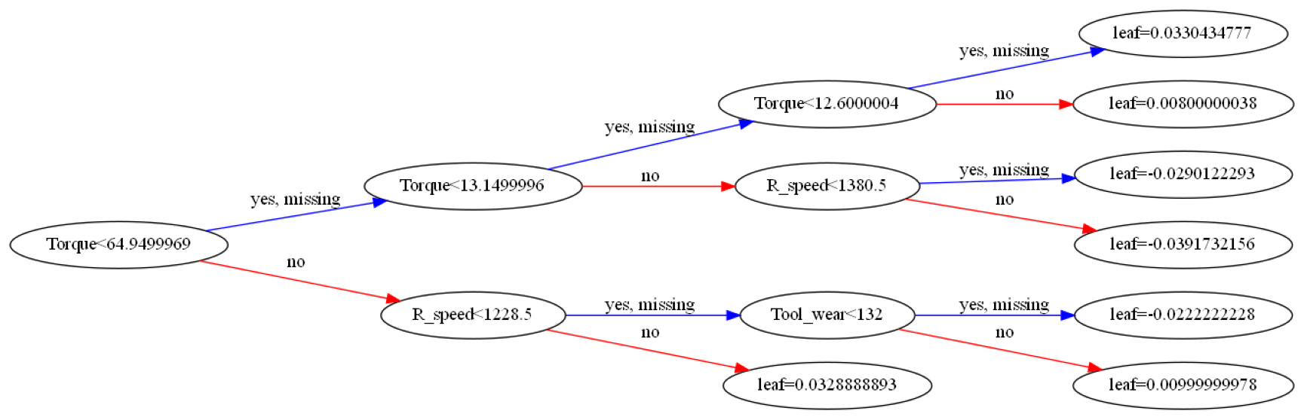
4.1 Classify whether the machine will fail or not
Decision Tree by XGBoost (Extreme Gradient Boosting)
Decision Tree by Gradient Boosting
2.3
2.4
n_estimators = 500
Learning rate = 0. 02
max_depth=6
Misclassification rate: 0.0135
F1-score = 0.877
n_estimators = 500
Learning rate = 0. 02
max_depth=6
Misclassification rate: 0.01305
F1-score = 0.862
Predict \ Actual | Normal | Failure
Normal | 1929 | 10
Failure | 20 | 41
Predict \ Actual | Normal | Failure
Normal | 1930 | 9
Failure | 18 | 43
Notes:
Here we tried to use boosting to ensemble learning methods that use a sequence of weak learners to make accurate predictions. Both boosting implement 500 estimators, 0.02 learning ratee with maximum depth of 6. They have torque as the most important feature with similar performance but XGBoost is slightly better in terms of Misclassification rate and F1-score. It is very interesting that torque only appears in one of the nodes in Decision Tree by Gradient Boosting.

Slide 16
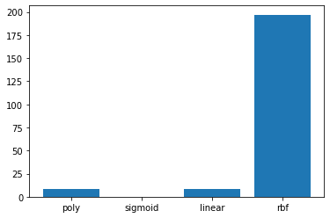
4.1 Classify whether the machine will fail or not
Support Vector Classification (SVC, with PCA)
2.5
PCA is implemented to avoid overfitting and noise.
Compare four kernels: Poly, Sigmoid, Linear, and RBF
RBF has the highest accuracy rate than other Kernels.
Pipeline
Scaling
PCA
(n=2)
SVC
(C=1)
Notes:
law

Slide 17
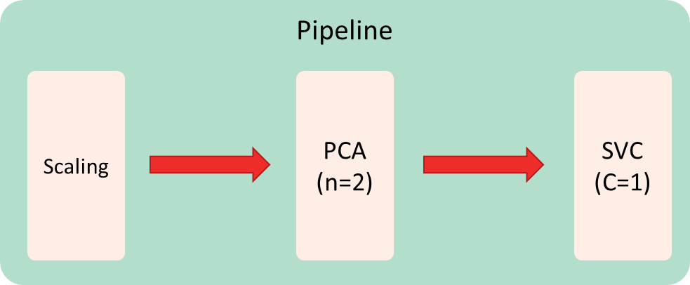

Slide 18
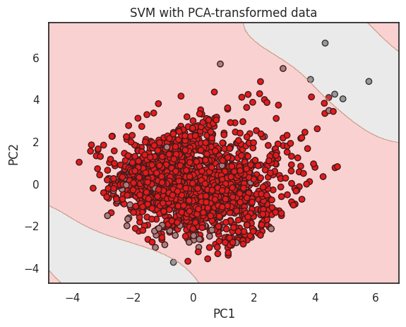
4.1 Classify whether the machine will fail or not
Support Vector Classification (SVC)
2.6
Most machine failures are concentrated at the upper right and lower left corners. More challenging to separate groups with a linear function.
Kernel: RBF (Radial Basis Function)
Can handle complex decision boundaries.
Good at handling imbalanced datasets.
However, it may be computationally expensive for large datasets.
Notes:
law

Slide 19
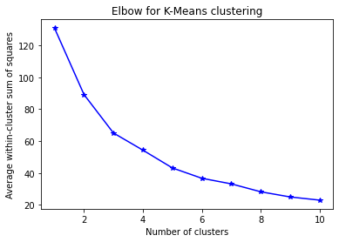
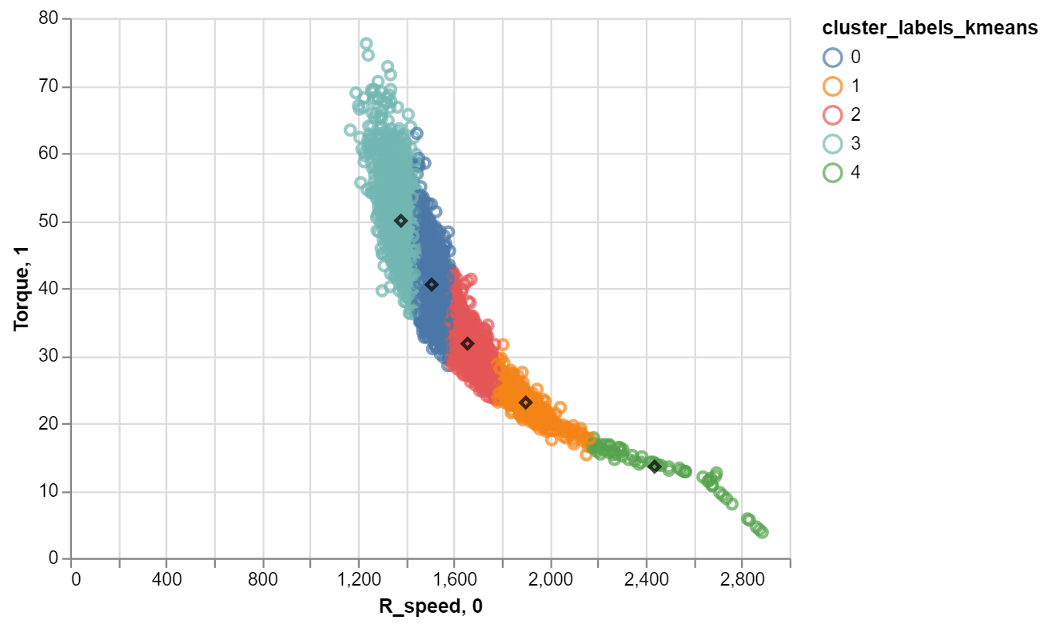
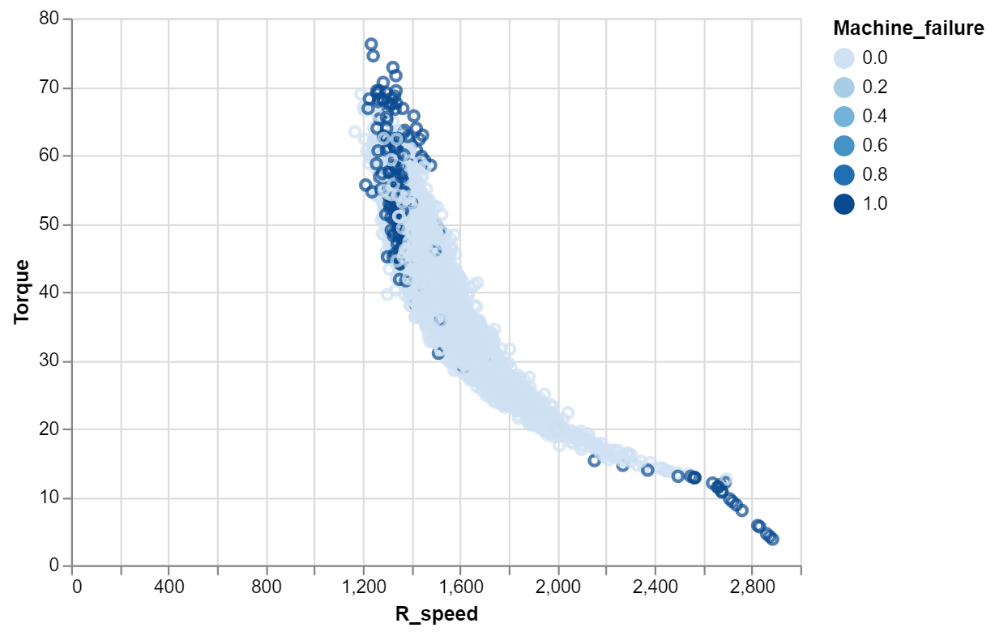
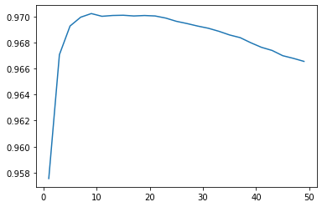
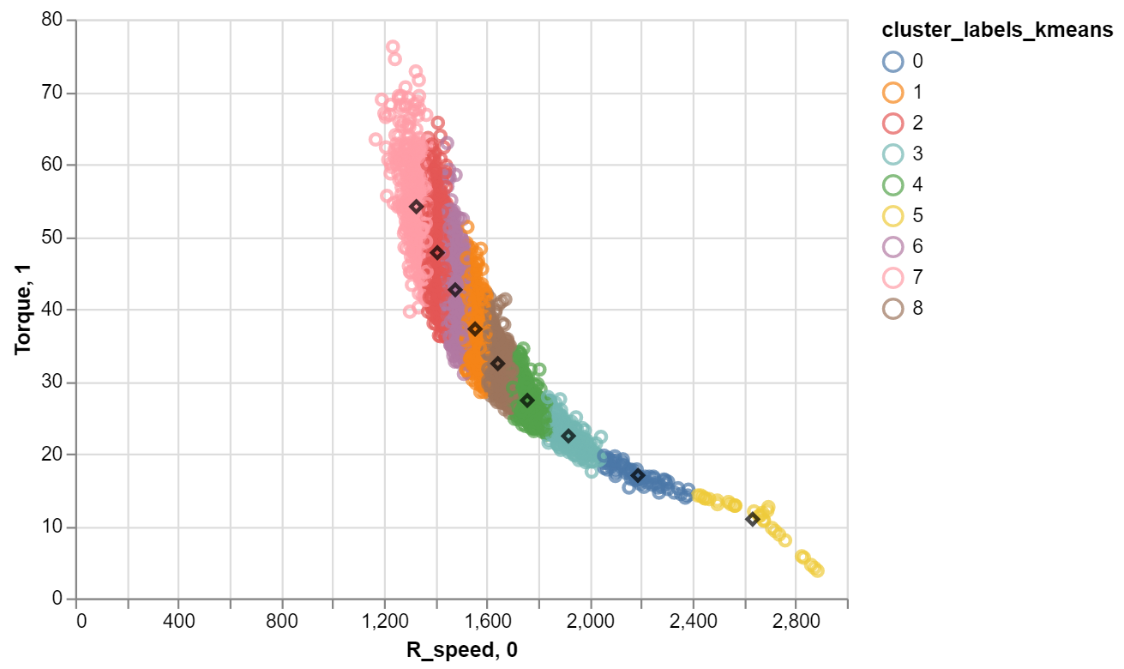
4.1 Classify whether the machine will fail or not
K-Nearest Neighbors (KNN)
2.7
Torque and R_speed are selected
Average within-cluster sum of squares of 5 clusters is 43.43 (Elbow)
Model with 9 clusters has the highest accuracy (0.972)
May have problem of overfitting
Notes:
law

Slide 20
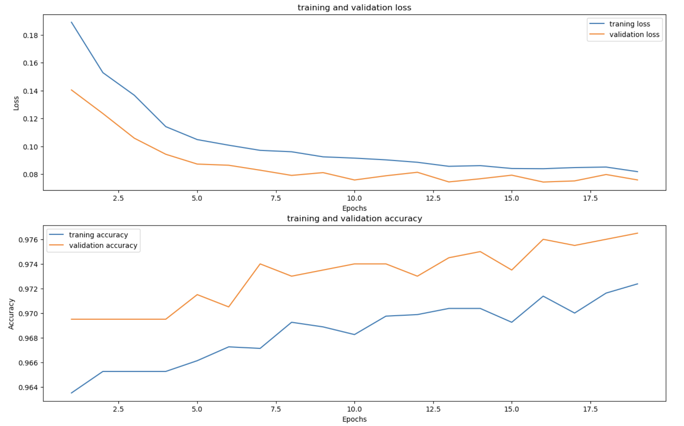
4.1 Classify whether the machine will fail or not
Neural Network
3
5 Dense Layer with ReLU activation function
5 Dropout Layer with randomly turning off 20% of neurons
Final Dense Layer with 1 neuron and sigmoid activation function
Loss Function: binary_crossentropy
Optimizer: Adam
Metrics: accuracy
Notes:
leo
which maps the output to a value between 0 and 1, making it suitable for binary classification tasks.
binary_crossentropy: Used as a loss function for binary classification model. It computes the cross-entropy loss between true labels and predicted labels.

Slide 21
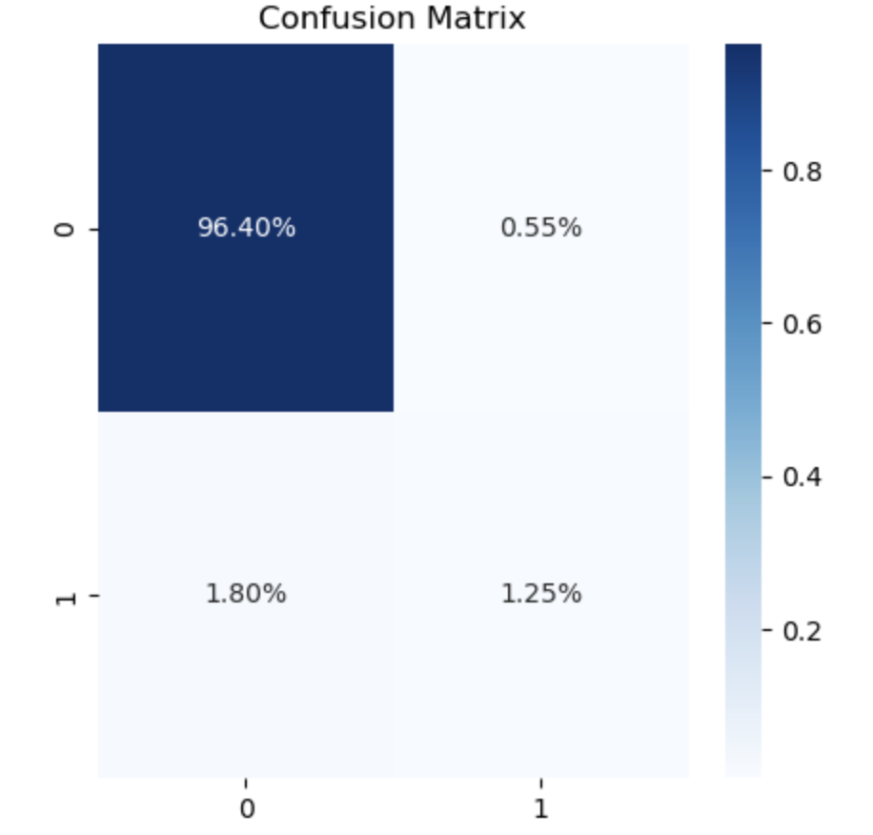
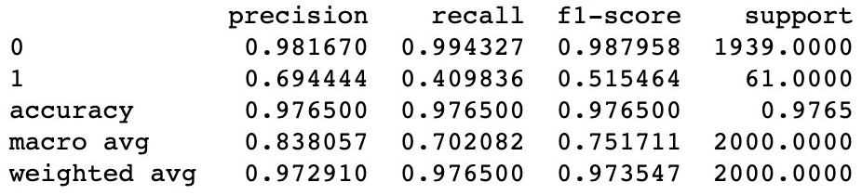
4.1 Classify whether the machine will fail or not
Neural Network
3

Slide 22
RESULT
Q2: Classify machine failure type
4
Notes:
akm

Slide 23
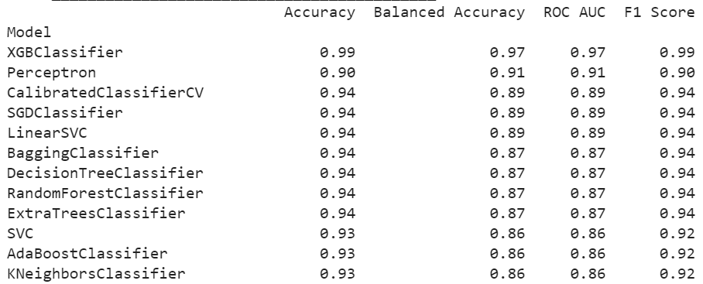
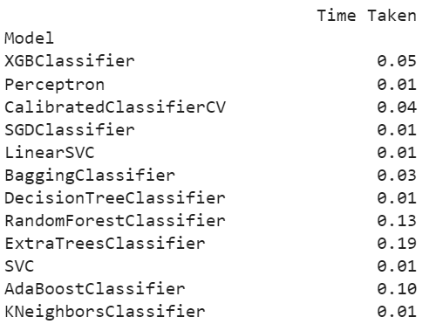
4.2 Classify what type of machine failure it experiences
TWF (Tool wear failure)
1.1
Fit the Lazy Classifier
Fit the XGBoost Model
Confusion Matrix
Fail
Not Fail
Fail
54
2
Not Fail
1
11
Misclassification Rate: 0.0441
Accuracy: 0.9559
Precision: 0.9140
Recall: 0.9405
F1 Score: 0.9265
Notes:
akm

Slide 24
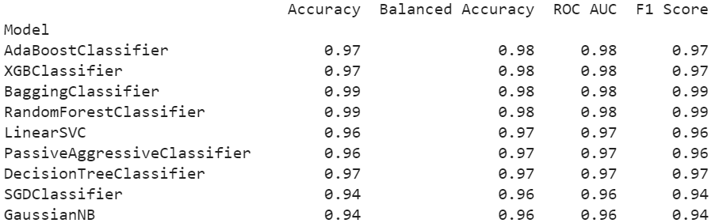
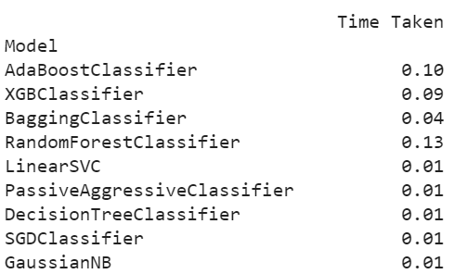
4.2 Classify what type of machine failure it experiences
HDF (Heat dissipation failure)
1.2
Fit the Lazy Classifier
Fit the Random Forest Model
Confusion Matrix
Fail
Not Fail
Fail
54
2
Not Fail
2
10
Misclassification Rate: 0.0588
Accuracy: 0.9412
Precision: 0.8988
Recall: 0.8988
F1 Score: 0.8988
Notes:
akm

Slide 25
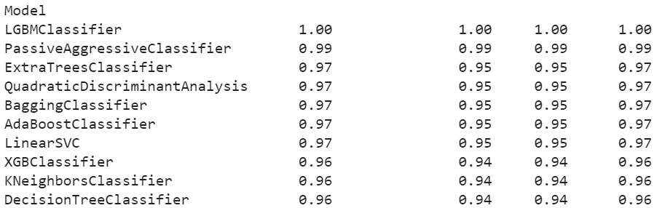
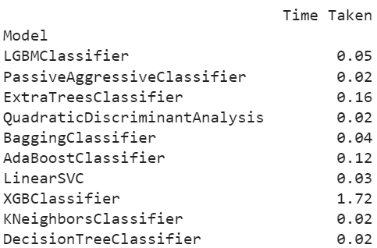
4.2 Classify what type of machine failure it experiences
PWF (Power failure)
1.3
Fit the Lazy Classifier
Fit the XGBoost Model
Confusion Matrix
Fail
Not Fail
Fail
54
2
Not Fail
1
11
Misclassification Rate: 0.0441
Accuracy: 0.9559
Precision: 0.9140
Recall: 0.9405
F1 Score: 0.9265
Notes:
akm

Slide 26
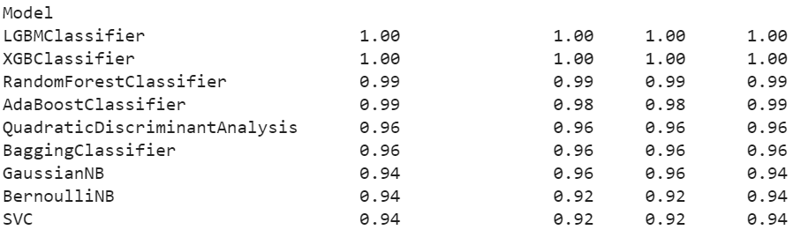
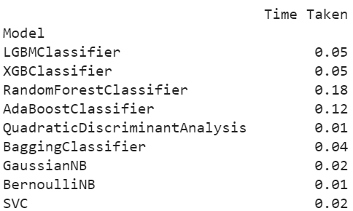
4.2 Classify what type of machine failure it experiences
OSF (Overstrain failure)
1.4
Fit the Lazy Classifier
Fit the XGBoost Model
Confusion Matrix
Fail
Not Fail
Fail
45
0
Not Fail
0
23
Misclassification Rate: 0.0000
Accuracy: 1.0000
Precision: 1.0000
Recall: 1.0000
F1 Score: 1.0000
Notes:
akm

Slide 27
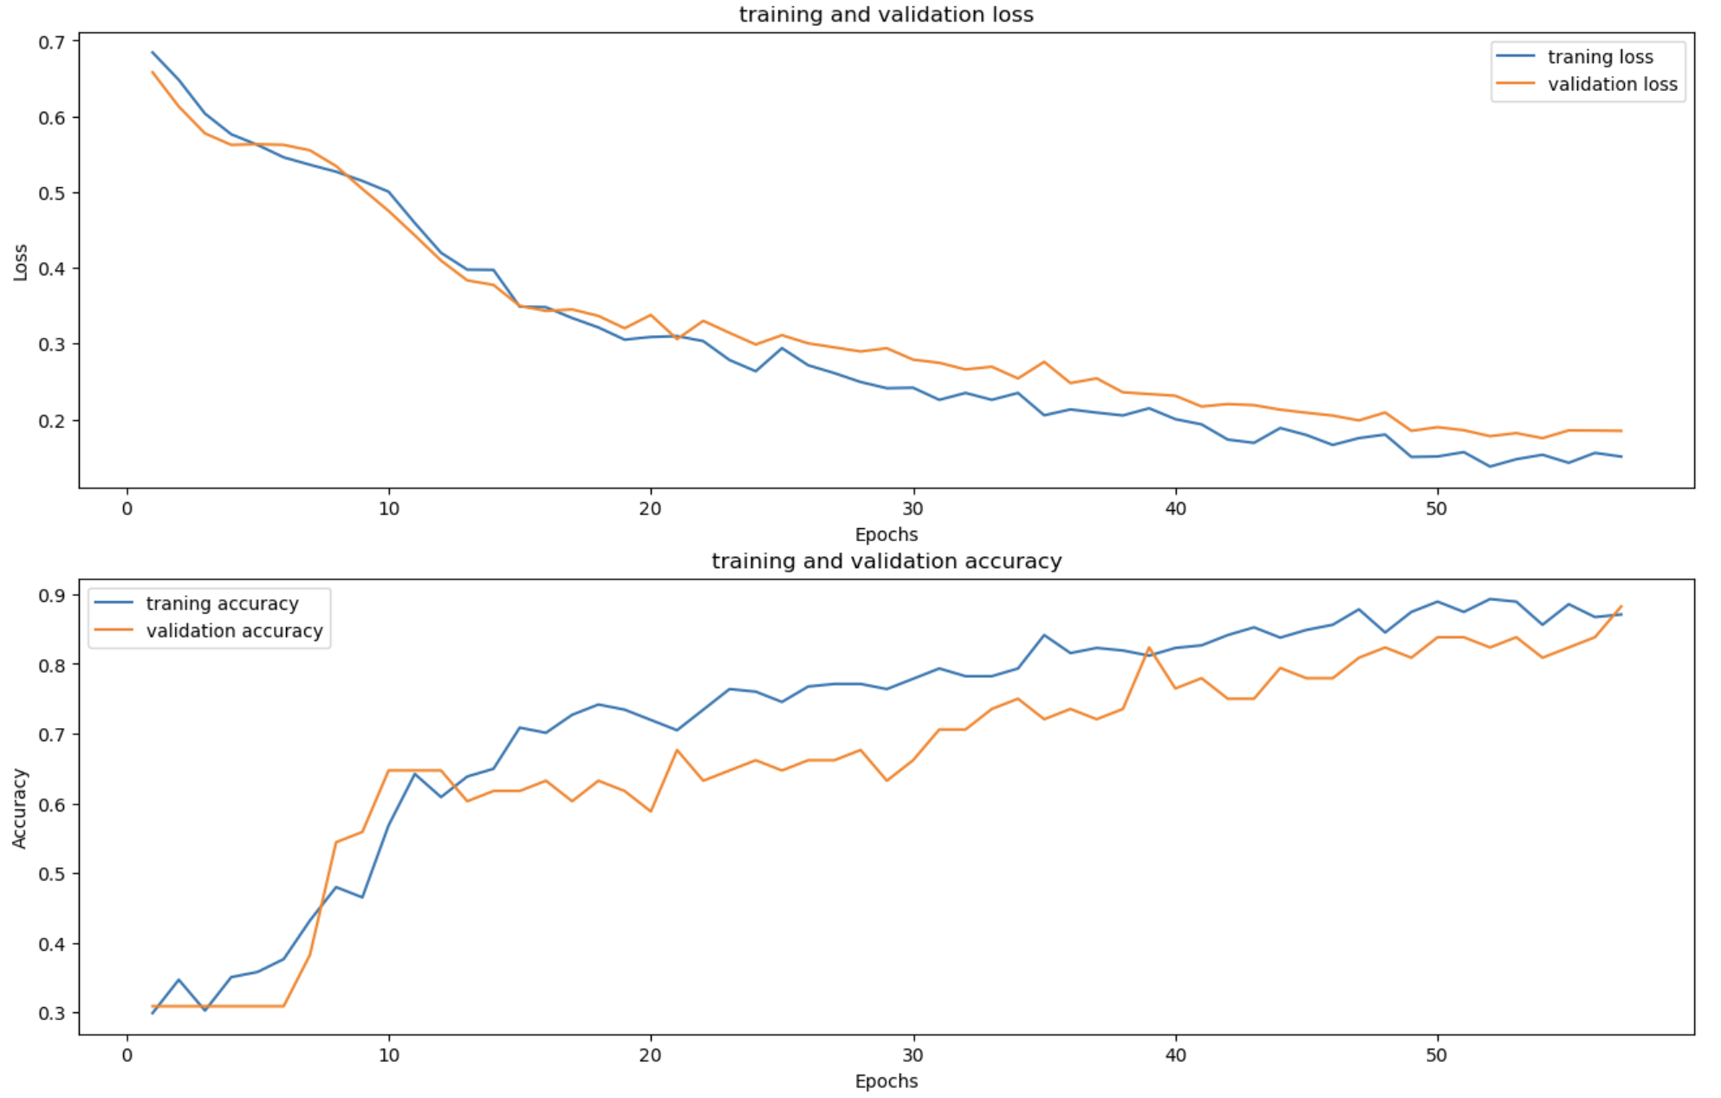
4.2 Classify what type of machine failure it experiences
Neural Network
2
5 Dense Layer with ReLU activation function
5 Dropout Layer with randomly turning off 20% of neurons
Final Dense Layer with 4 neurons and sigmoid activation function
Loss Function: binary_crossentropy
Optimizer: Adam
Metrics: accuracy
Notes:
leo
which maps the output to a value between 0 and 1, making it suitable for each type.

Slide 28
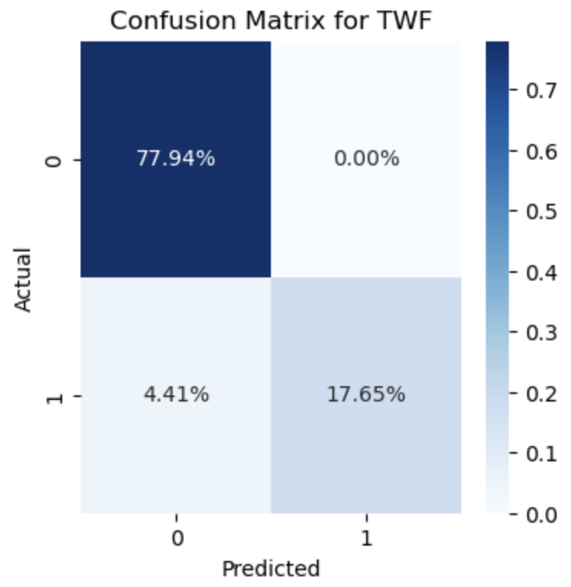
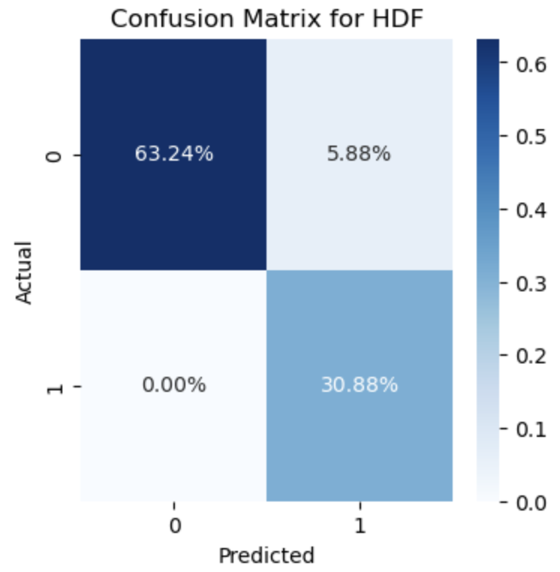
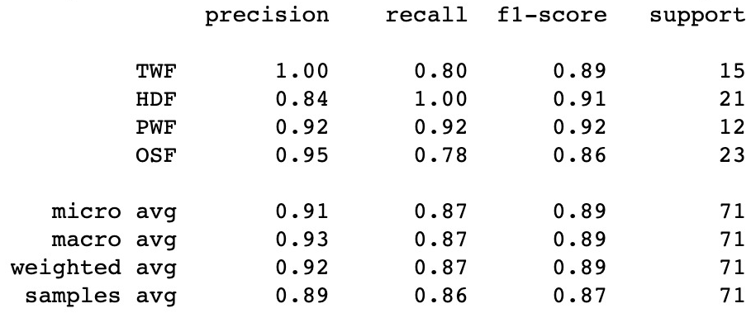
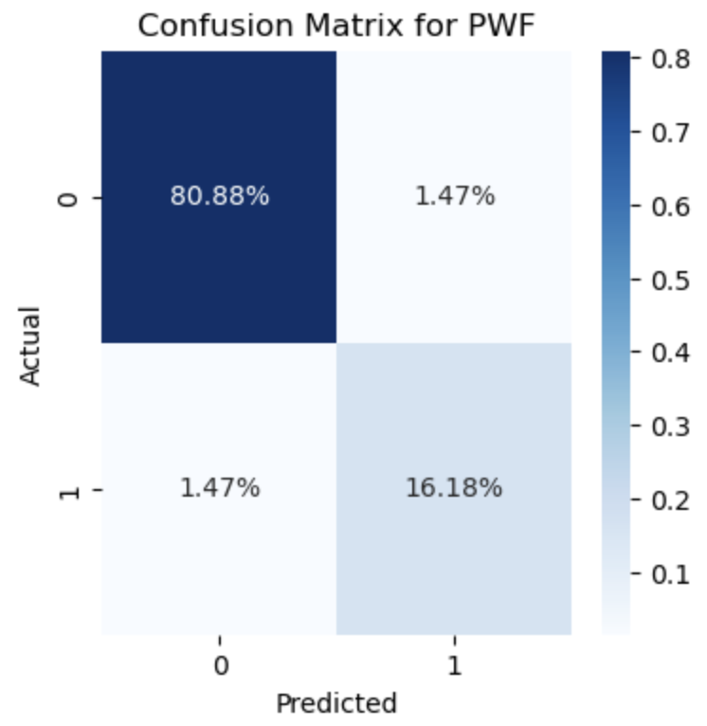
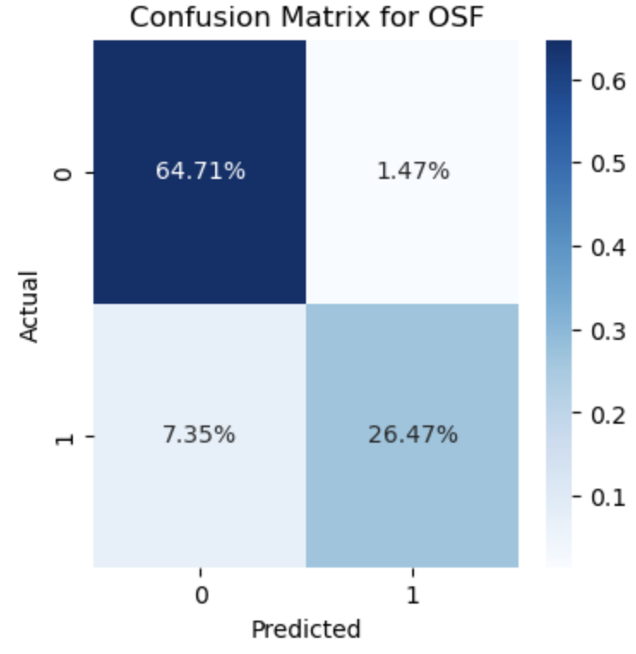
4.2 Classify what type of machine failure it experiences
Neural Network
2

Slide 29
5
CONCLUSION
Notes:
law

Slide 30
5.1 Classify whether the machine will fail or not – Model Comparison
Model |  | Misclassification rate | F1-Score
Decision Tree | Gini | 1.85% | 84.2%
 | Entropy | 1.95% | 83.4%
Bagging |  | 1.29% | 87.1%
Random Forest |  | 1.32% | 84.8%
Boosting | XGBoost | 1.35% | 87.7%
Boosting | Gradient Boosting | 1.30% | 86.2%
SVC |  | 3.15% | 52.6%
KNN |  | 2.80% | 84.6%
Neural Network |  | 2.35% | 97.7%
RBF kernel can help overcome imbalanced dataset, it could still be biased towards the majority class and may have lower performance; whereas Decision Trees is more effective as they can focus on the minority class, identify specific features associated, and be more robust to noisy features and can adapt to the local structure of the data.
The most important feature is Torque, from Random Forest and both decision tree with boosting
Notes:
law

Slide 31
5.2 Classify what type of machine failure it experiences – Model Comparison
Algorithms | Performance Metrics | TWF | HDF | PWF | OSF
From chosen ML Model | Misclassification Rate | 4.41% | 5.88% | 4.41% | 0.00%
 | F1-score | 92.65% | 89.88% | 92.65% | 100.00%
From Neural Network | Misclassification Rate | 0% | 0.16% | 0.08% | 0.05%
 | F1-score | 89% | 91% | 92% | 96%
Notes:
law

Slide 32
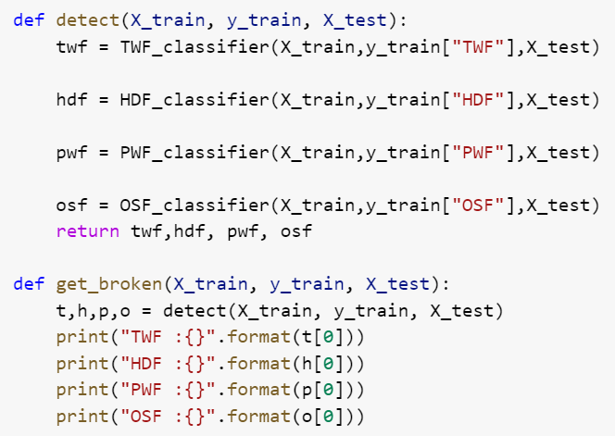
5.2 Classify what type of machine failure it experiences – Build a prediction function
Since the performance of each model for each failure type is good enough, we then combine each failure type’s models into one function to predict the failure type that tend to occur for the failed machines.
FUNCTION
INPUT
Type | L
Air temperature | 300
Process temperature | 311
Rotational speed | 1372
Torque | 60
Tool wear | 212
OUTPUT
TWF | Functional
HDF | Functional
PWF | Functional
OSF | Malfunctioned
This failed machine is predicted to have overstrain failure
Notes:
akm

Slide 33
5. Conclusion
1
Classify whether the machine will fail or not
Due to the imbalanced characteristic of the dataset, we mainly use F1-score to evaluate the model's performance.
Neural network performs the best in detecting machine failure, with the F1-score of 97.65%.
Compared to other models, the SVC model we constructed has a significantly low F1-score.
2
Classify what type of machine failure it experiences
Among all failure types, it is easier to detect overstrain failure (OSF) as the F1-score of the model for this type of failure is the highest.
As the collection of individual methods outperforms the neural network method, we developed the type of malfunction classifying function based on the individual methods.
Notes:
law

Slide 34
THANK YOU

